Slide 1
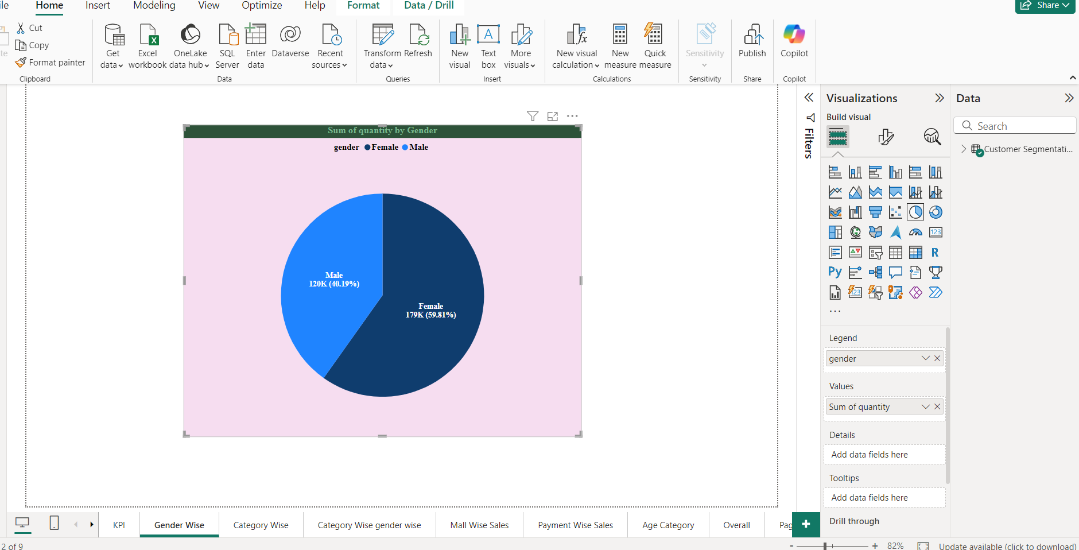
Customer Segmentation Analysis
Pie Chart (Sum of Quantity By Gender)

Slide 2
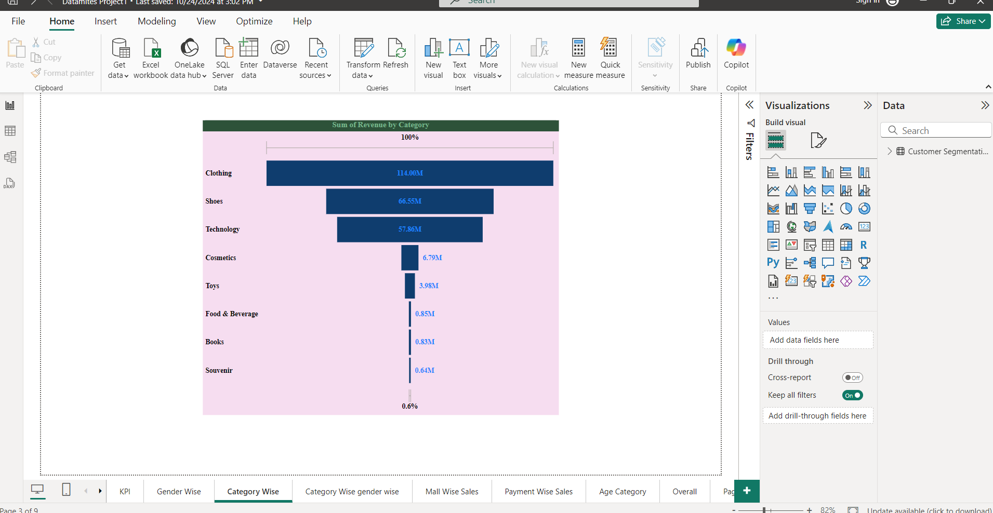
Funnel Chart(Sum of Revenue By Category)

Slide 3
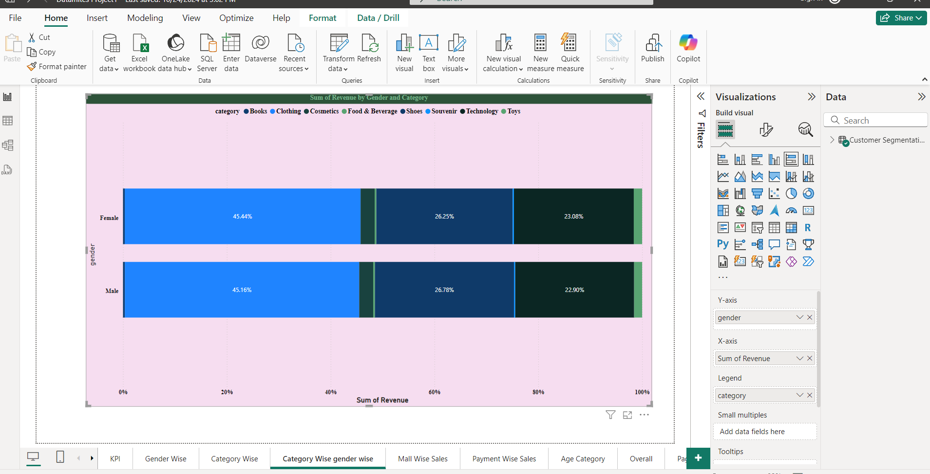
Stacked Bar Chart( Sum of Revenue by Gender and Category)

Slide 4
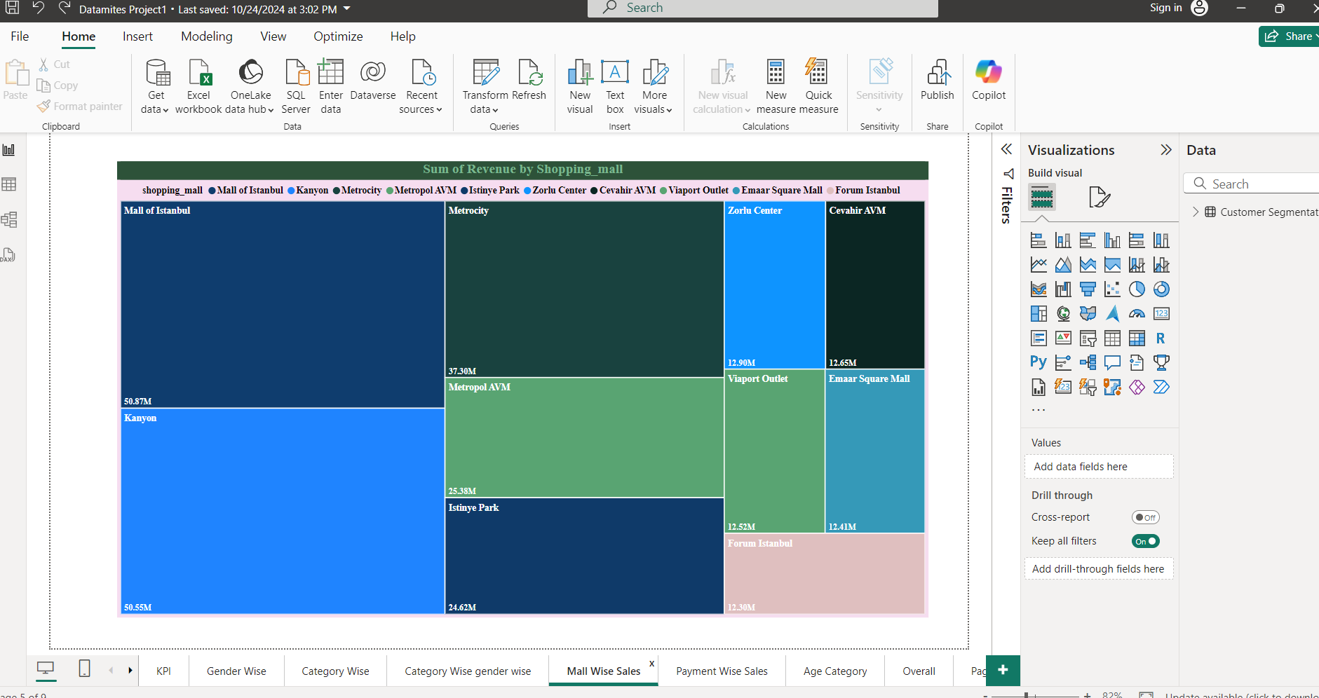
Tree Map Chart (Mall Wise Sales)

Slide 5
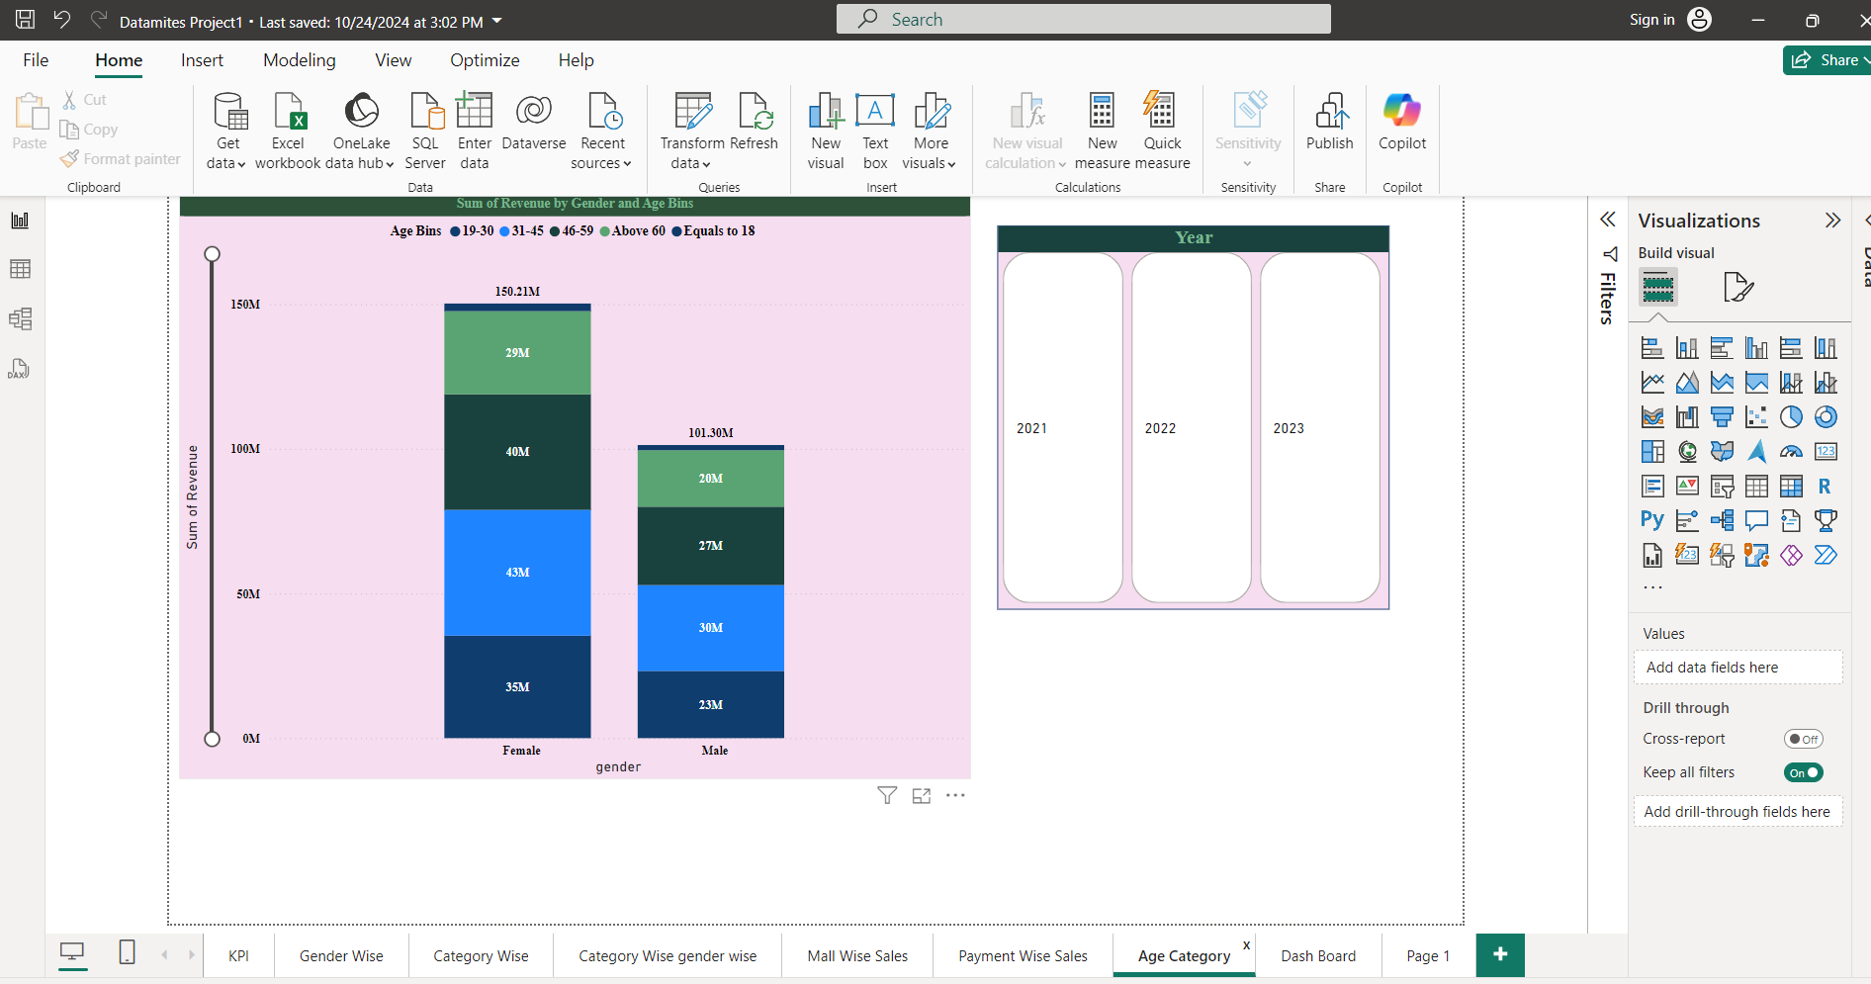
Stacked Column Chart (Sum of Revenue by Gender and Age Bins)

Slide 6
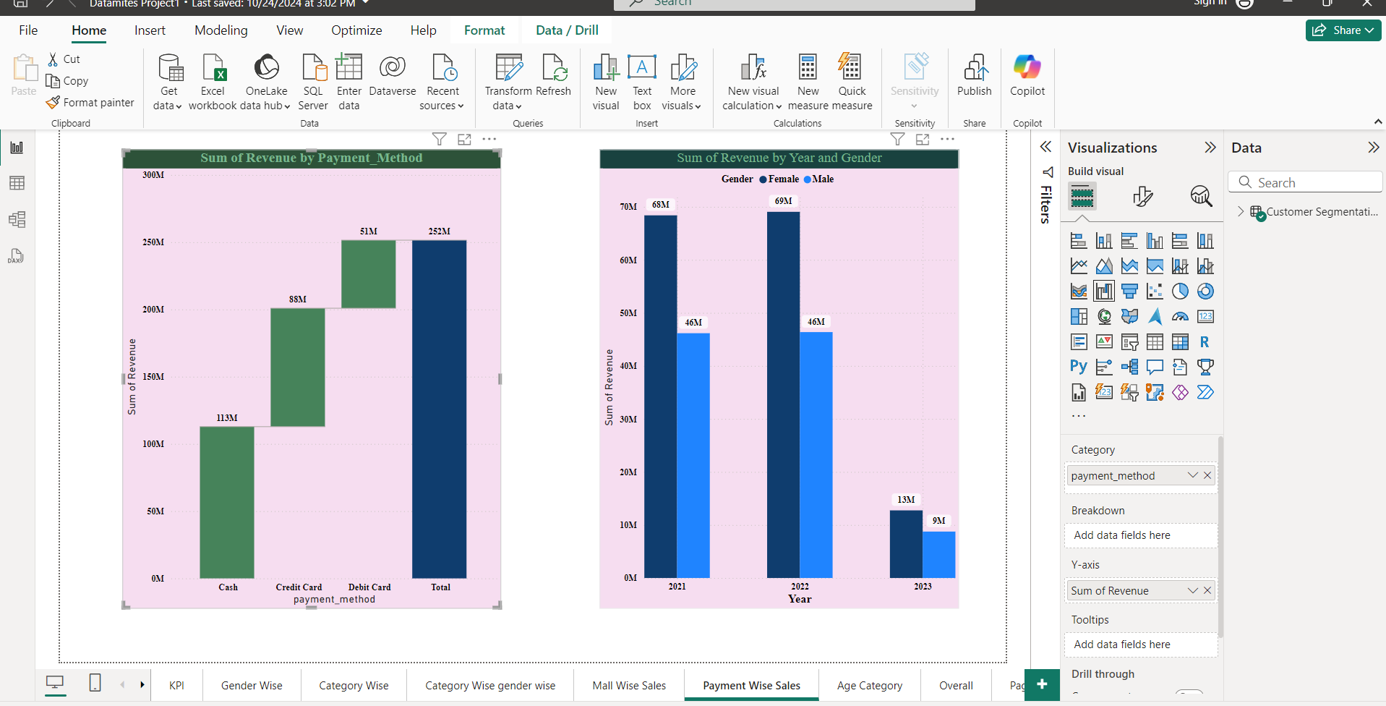
Water Fall Chart & Clustered Column Chart (Sum of Revenue by Payment Method & Year and Gender)

Slide 7
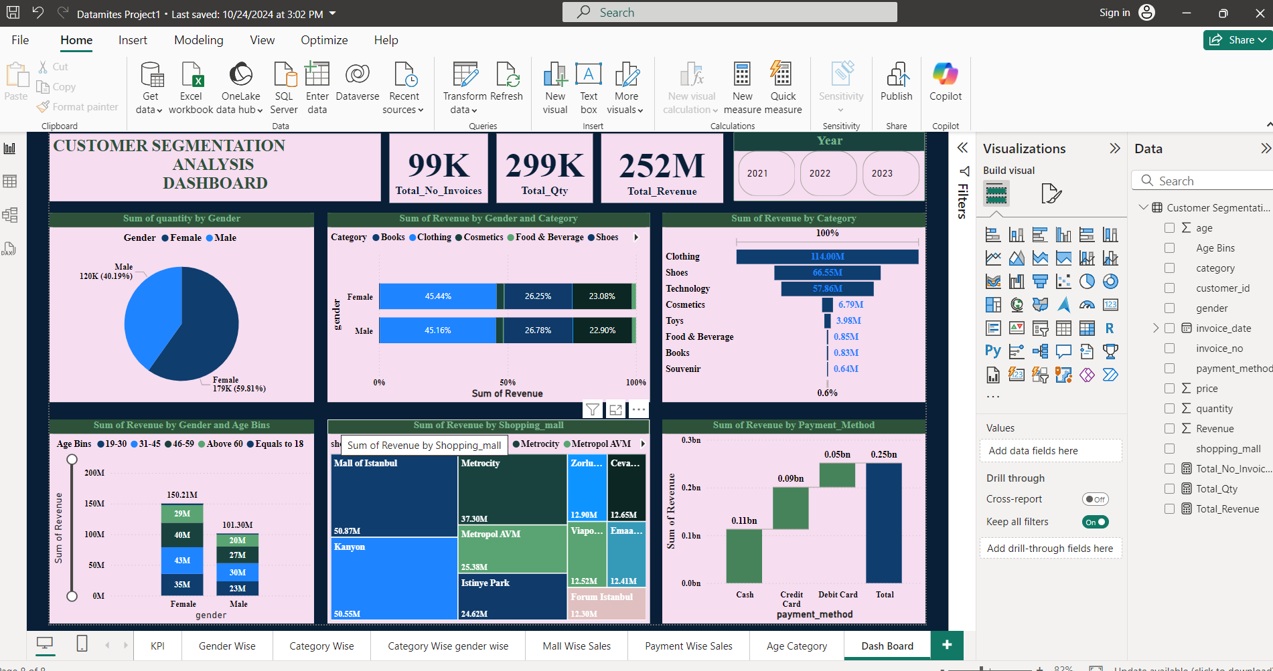
Dashboard

